Slide 1


Transparent acrylic
LED light
Plastic Bottles
‘Microwavable’ Food Containers
Only intended for one time use
High temperatures causes chemicals to leach out of the plastic
1
PETE
Plastic Bottles
‘Microwavable’ Food Containers
Only intended for one time use
High temperatures causes chemicals to leach out of the plastic
Plastic Bottles
‘Microwavable’ Food Containers
Only intended for one time use
High temperatures causes chemicals to leach out of the plastic
LED light
Information cut out

Slide 2
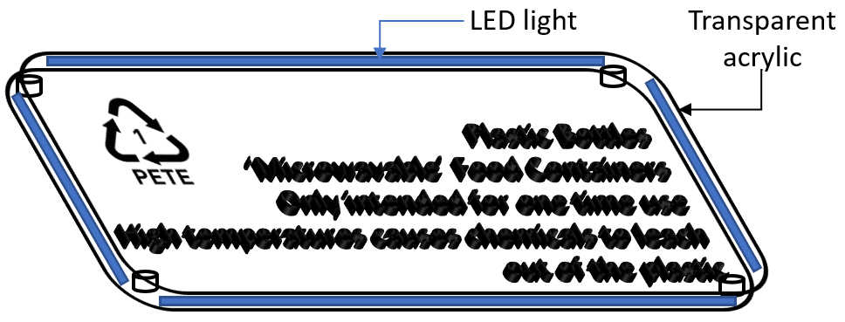
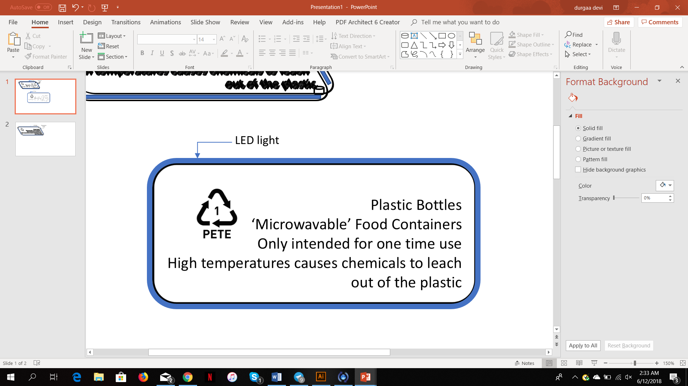
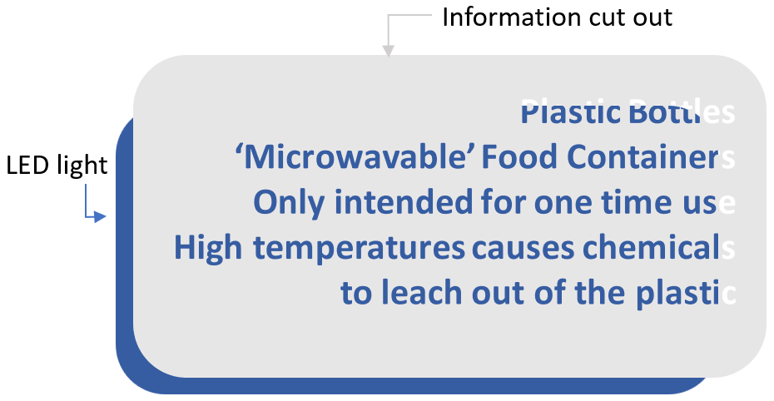

Slide 3
problem | Soln after testing
Our words were engraved on a white acrylic with LED light strips surrounding it. Users said the words were not clear from far especially with the lights. | We decided to change the acrylic to black instead so the words would be more visible with the lights.
Users said the lights were too glaring and difficult to read the information. | We added another transparent acrylic over and added the LED light strips to the side to an angle such that the light does not shine directly at the user.
We laser cut out the information on acrylic and placed LED lights at the back such that when the user hits the info the LED lights up and the light shines through the words. Users said the words were hard to read because of the glaring as the light comes out through the laser cut. | We decided to engrave the wording and place LED around it instead of the LED at the back and shining through it.

Slide 4
iterations
solution
Our words were engraved on a white acrylic with LED light strips surrounding it.
Users said the words were not clear from far especially with the lights.
problem
We laser cut out the information on acrylic and placed LED lights at the back such that when the user hits the info the LED lights up and the light shines through the words.
Users said the words were hard to read because of the glaring as the light comes out through the laser cut.
Users said the lights were too glaring and difficult to read the information.
problem
Users said the LED lights made the words less clear because of the white background.
solution
We decided to engrave the wording and place LED around it instead of the LED at the back and shining through it.
We added another transparent acrylic over and added the LED light strips to the side to an angle such that the light does not shine directly at the user.

Slide 5
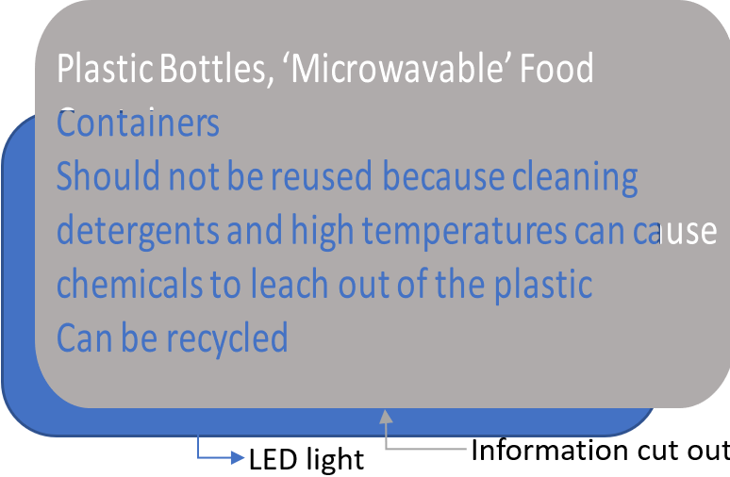
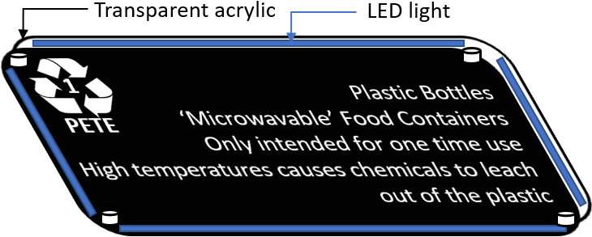
1st
problem
iteration
problem
Users said the lights were too glaring and difficult to read the information.
Also, many suggested we change the acrylic colour to black.
Users said the words were hard to read because of the glaring as the light comes out through the laser cut.
We laser cut out the information on acrylic and placed LED lights at the back such that when the user hits the info the LED lights up and the light shines through the words.
3rd
2nd
iteration
iteration
We decided to engrave the wording and place LED around it instead of the LED at the back and shining through it.
We decided to engrave the words and place the LED surrounding the information displayed.
We added another transparent acrylic over and added the LED light strips to the side to an angle such that the light does not shine directly at the user.

Slide 6
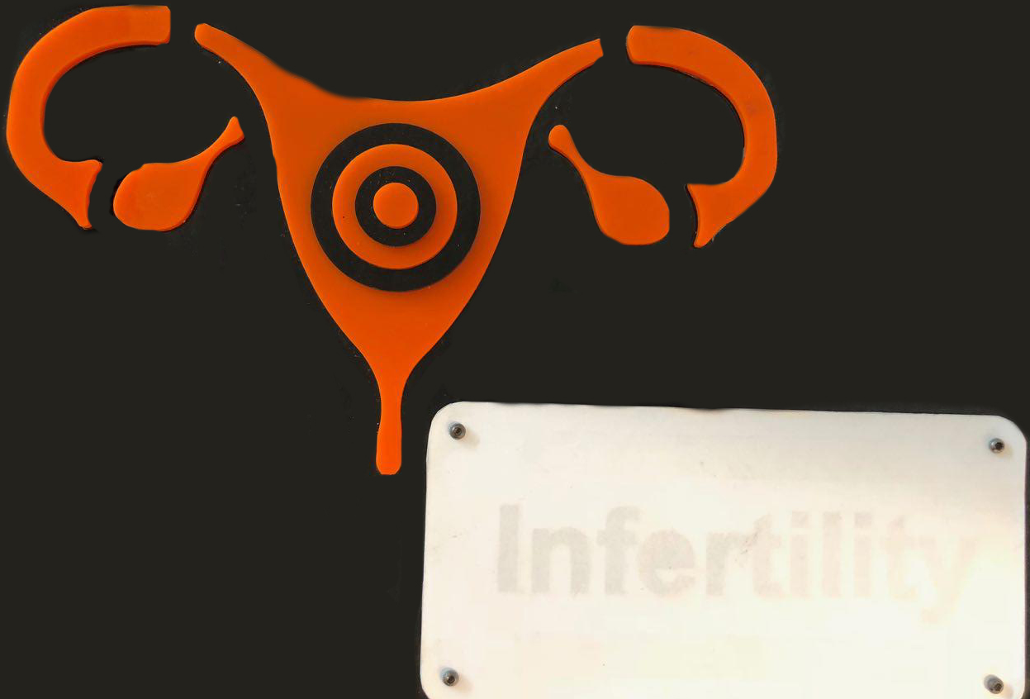
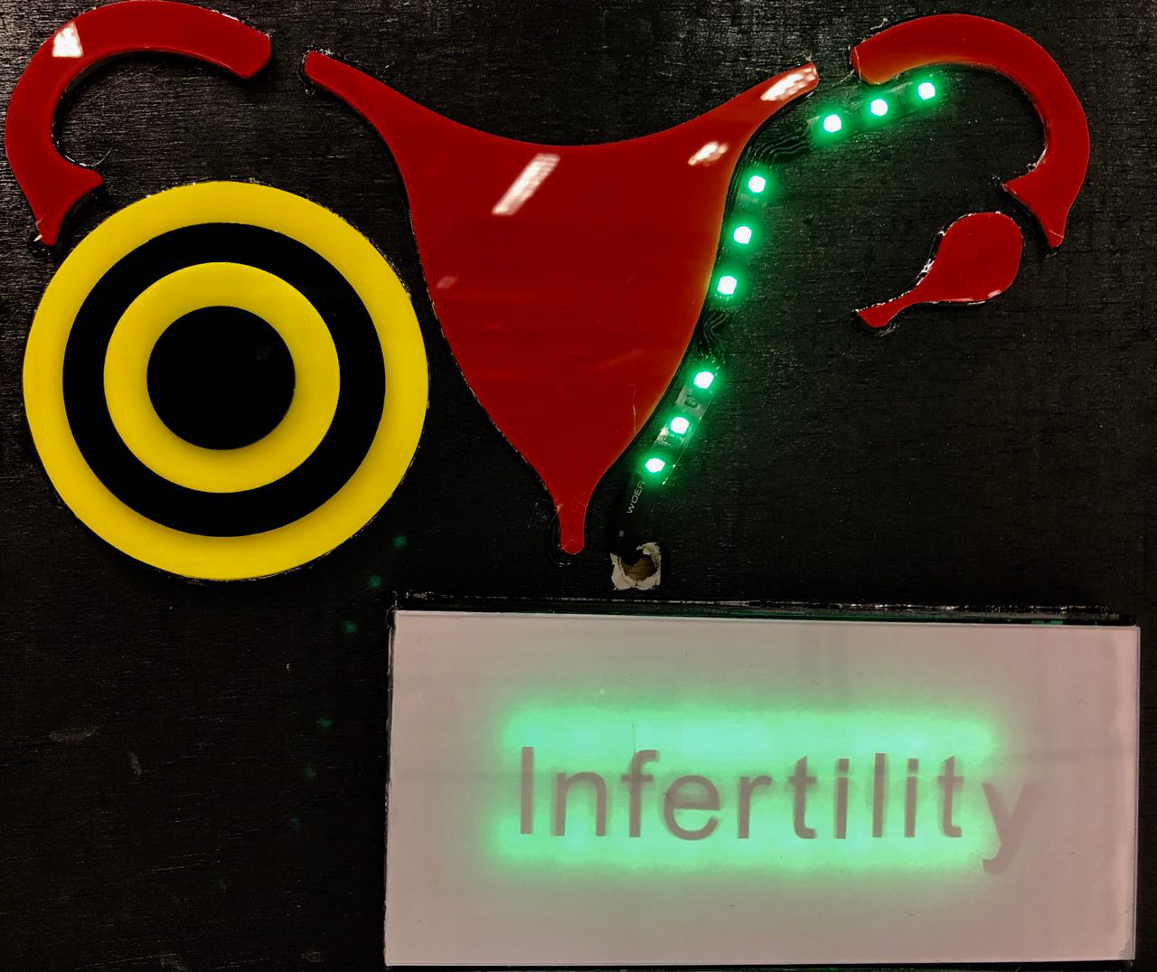
1st
iteration
2nd
iteration
We laser cut the outline of the organs & placed LED behind the word (disease) such that when hit, the word becomes clearer.
We made the target a different colour from the organ, made the target bigger & placed LED light around it. Also, we changed the thickness of the paper.
problem
Users said the target was hard to hit and that the word (disease) was not clear despite the light shining.
They suggested we change the paper used for our lightbox.

Slide 7


REDUCE
REUSE
RECYCLE

Slide 8
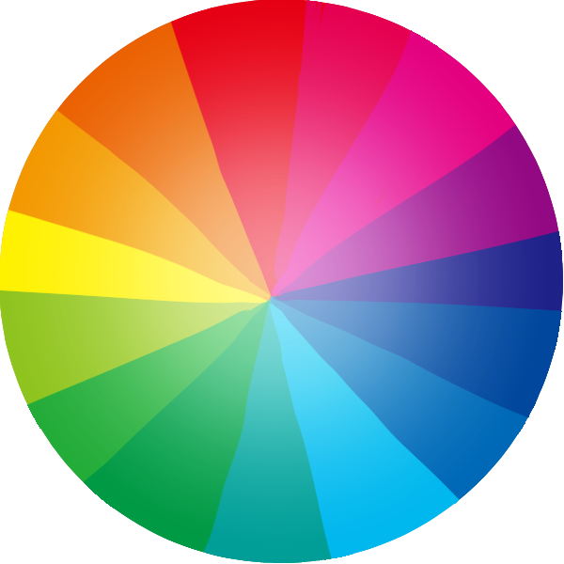


How willing will you be to play this game in a public setting? (1- very unwilling & 5- very willing)
I knew the harm of what consuming from plastic does to my health?
(1- did not know at all & 4-knew very well)

Slide 9

INCENTIVES
(PRIZES, VOUCHERS)
BRIGHT FLASH LIGHT & LIGHTS
SIMPLICITY OF GAME PLAY
ACCESIBILITY
INFORMATIVE
WHAT WILL ATTRACT PLAYERS TO PLAY?

Slide 10
2M
1M
3M
OPTIMAL DISTANCE TO THROW BOTTLES FROM

Slide 11
Bottle with water
Bottle with coin
Bottle without anything
Users found it easier to throw bottles without anything inside.
The coin dropped off while throwing.
The water caused the bottles to dent.

